Slide 1
Control Structures in Python

Slide 2
A program’s control flow is the order in which the program’s code executes.
The control flow of a Python program is regulated by conditional statements, loops, and function calls.
Python has three types of control structures:
Sequential - default mode
Selection - used for decisions and branching
Repetition - used for looping, i.e., repeating a piece of code multiple times.

Slide 3
Sequential
Sequential statements are a set of statements whose execution process happens in a sequence. The problem with sequential statements is that if the logic has broken in any one of the lines, then the complete source code execution will break.
a=20
b=10
c=a-b
print("Subtraction is : ",c)

Slide 4
2. Selection/Decision control statements
also known as Decision control statements or branching statements.
The selection statement allows a program to test several conditions and execute instructions based on which condition is true.
Some decision control statements are:
If
If-else
nested if
if-elif-else

Slide 5
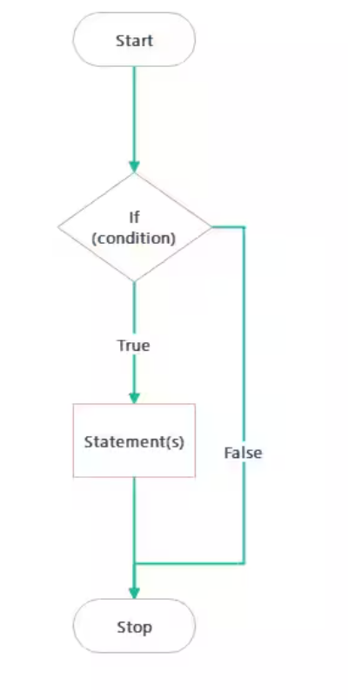
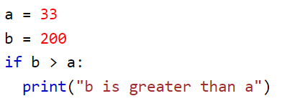
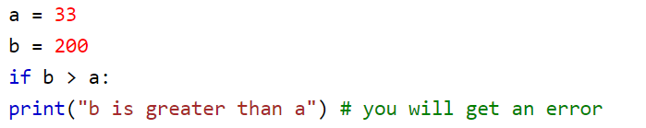
If statement
The if statement executes a statement if a condition is true

Slide 6
To check whether given number is even or not
n = 10
if n % 2 == 0:
print("n is an even number")
Write a program that prompts a user to enter two integer values. Print the message ‘Equals’ if both the entered values are equal
n1= eval(input(“Enter first number:”))
n2= eval(input(“Enter second number:”))
if n1-n2==0:
print(“Both the numbers are equal”)

Slide 7
Write a program that prompts a user to enter the radius of a circle. If the radius is greater than zero then calculate and print the area and circumference of the circle
from math import pi
rad=eval(input(“Enter the radius of the circle:”))
if rad>0:
Area= rad*rad*pi
print (“Area of the circle is:”, Area)
Circumference= 2*pi*rad
print (“Circumference of the circle is:”,Circumference)

Slide 8
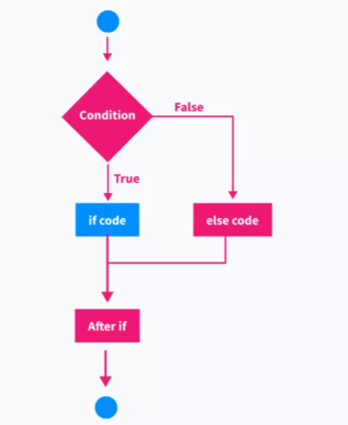
if-else statement
If we want to execute a block of code when the condition is false, we can use the ‘else’ statement along with the ‘if ’ statement in python
if condition:
Statement to execute if condition is true
else:
Statements to execute if condition is false

Slide 9
Program to prompt a user to enter two numbers. Find the greater number
n1= int(input(“Enter first number:”))
n2= int(input(“Enter first number:”))
if n1>n2:
print(n1,“is greater than”,n2)
else:
print(n2,“is greater than”,n1)

Slide 10
Program to check whether a person is eligible to vote or not
age= int(input(“Enter your age:”))
If age>=18:
print(“you are eligible to vote.”)
else:
print(“you are not eligible to vote.”)

Slide 11
Program to check whether a number is even or odd
number= int(input(“Enter a number:”))
if number%2==0:
print(“The number is even”)
else:
print(“The number is odd”)

Slide 12
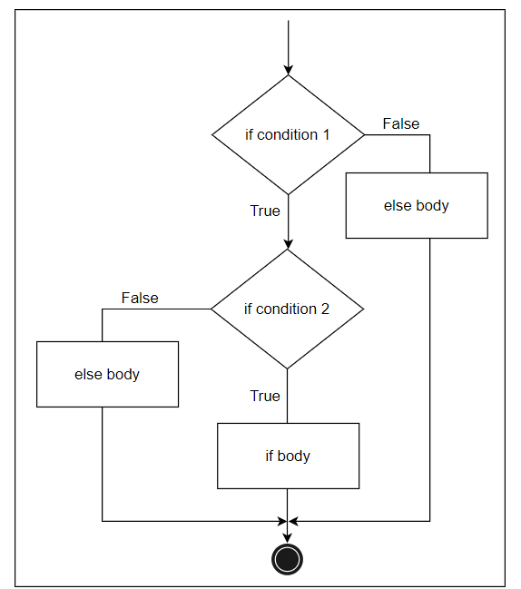
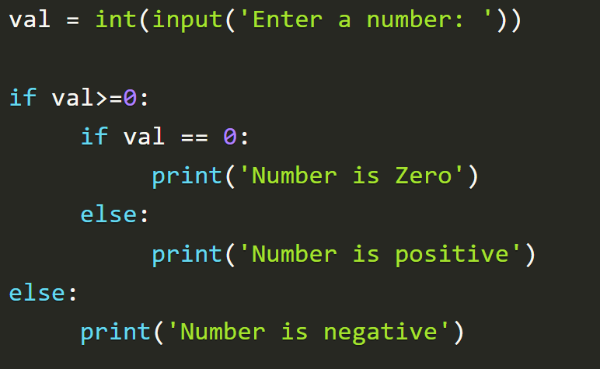
Nested if
Nested if statements are an if statement inside another if statement

Slide 13
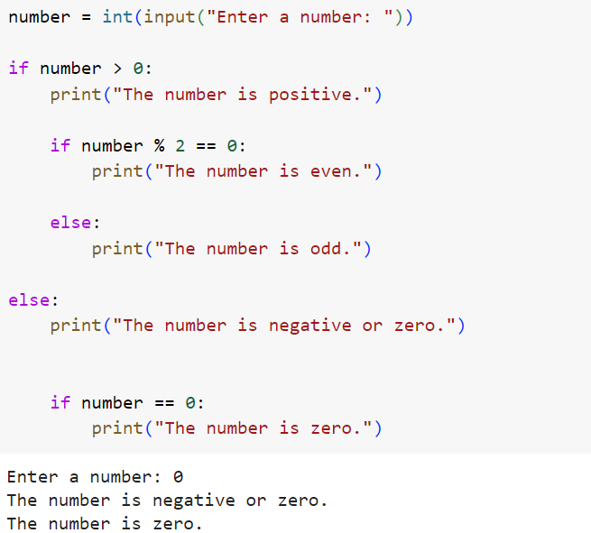
Write a Python program that prompts the user for a number and determines if it is positive, negative, or zero, and if positive, checks whether it is even or odd.

Slide 14
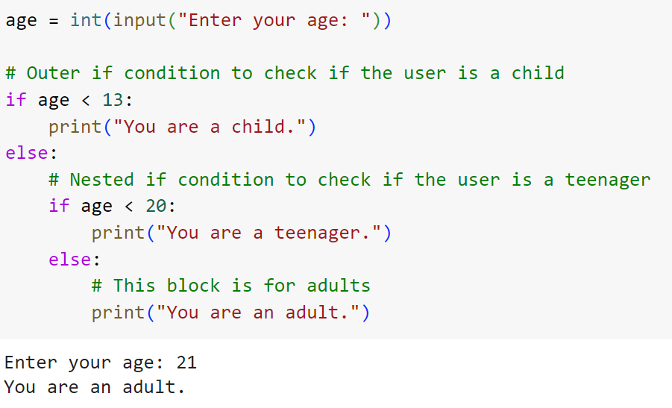
Write a Python program that prompts the user to enter their age and categorizes them as a child, teenager, or adult based on their input

Slide 15
elif statement
A user can choose from a variety of alternatives
The if statements are executed from top to down.
In this variant of ‘if statement’, there are many else if conditions declared.
If the first condition does not satisfy then the next condition is executed.
But if this condition also does not satisfy then the next condition is executed.
If none of the conditions is true, then the final ‘else’ statement will be executed

Slide 16
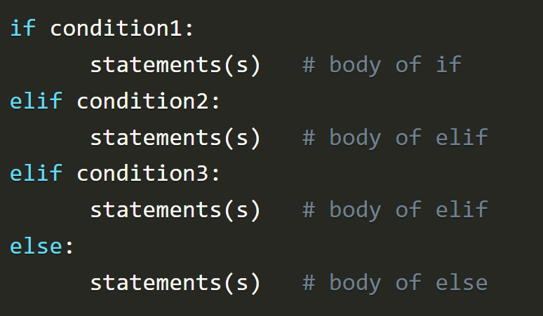
elif statement

Slide 17
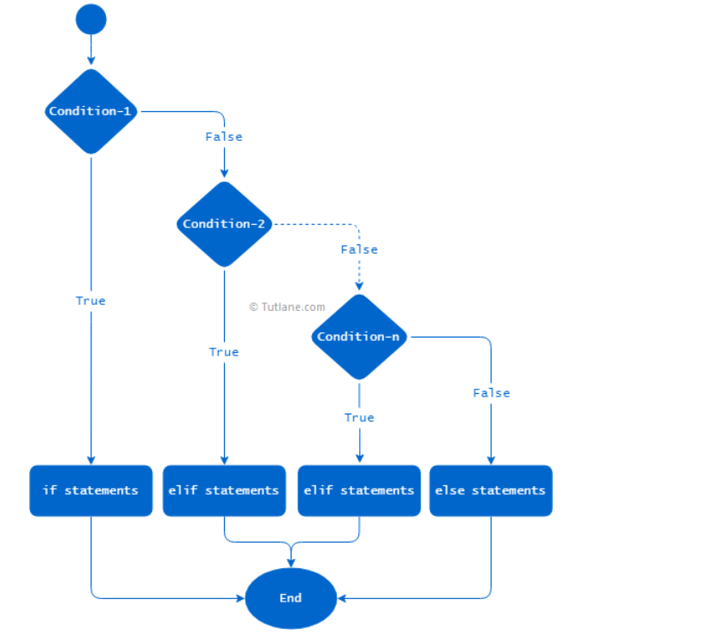
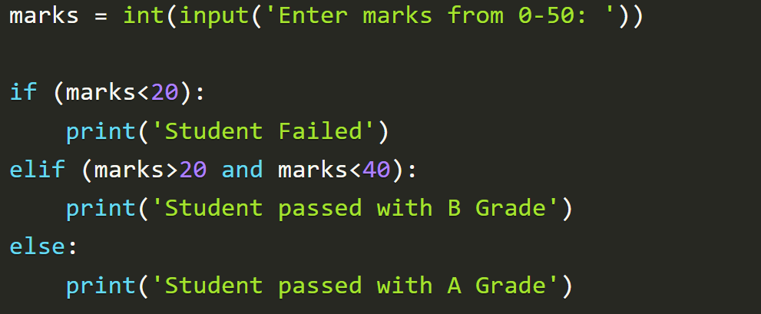
elif statement

Slide 18
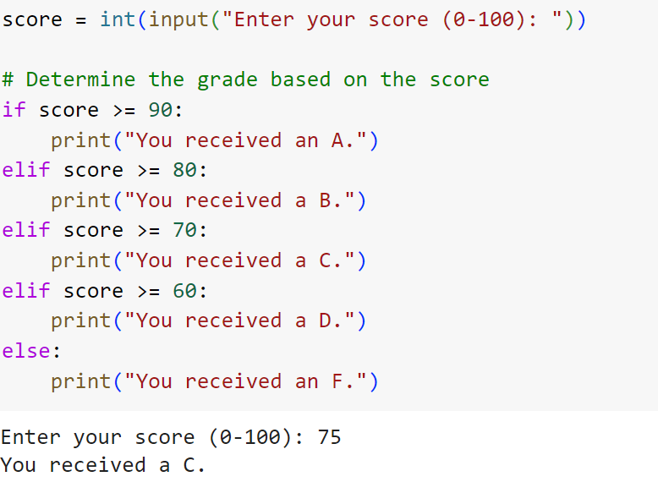
Example

